Slide 1
Power BI - Intermediate
Grant Shannon
Oct 2024
`

Slide 2
Housekeeping
Student check
Installation and environment setup
Download install PBI desktop client
Connect to github repo
https://github.com/gpsuser/PBI
Get data files
10 min break on the hour (time permitting)
Hands on course

Slide 3
Agenda
Data Modelling Concepts
Dimensional Modelling
Dimensional Modelling - Business Case
Designing a Data Model
Dimensional Model
Implementing a Data Model
Dimensional Model – Star Schema
Including Measures in the Data Model
Dax Aggregation within a Dimensional Model
Generating Reports

Slide 4
Data Modelling

Slide 5
Data Modelling Re-cap
Data warehouse – large store of data for analytics and reporting
Data model – structured and logical organization of data showing relationship between data elements
Multidimensional schema – model different dimensions to track entities/actions concerning data warehouse activities
Referred to as dimensional modelling
A good starting point to understanding multidimensional schema is the star schema

Slide 6
Business logic behind dimensional modelling
Dimensional models:
optimise performance,
simplify data management,
enhances analytical capabilities, and
supports scalability and flexibility
Preferred choice for data warehousing and business intelligence applications
Dimensional modelling: On-premises vs. cloud implementations

Slide 7
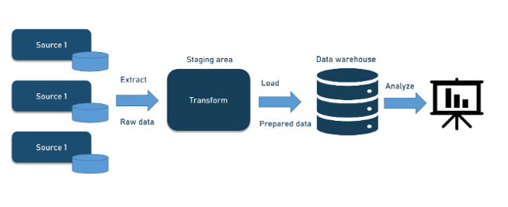
On Premise Pattern
On premise Extract Transform Load (ETL) architecture

Slide 8
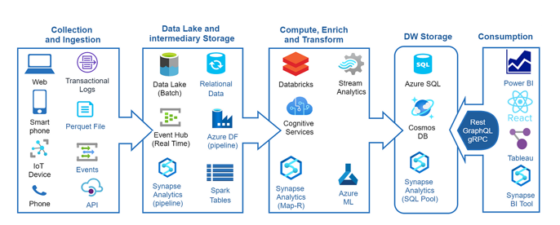
Cloud Pattern
Cloud based Extract Load Transform (ELT) architecture

Slide 9
Business logic behind dimensional modelling more detail
Improved Query Performance
Fact tables store large amounts of transactional data, while dimension tables store descriptive attributes. This separation allows for more efficient queries, as the database can quickly join smaller dimension tables with the fact table
2. Simplified Data Management
By organizing data into fact and dimension tables, you reduce redundancy and ensure consistency. Dimension tables centralize descriptive data, making it easier to update and maintain
3. Enhanced Data Analysis
Star schemas facilitate complex queries and reporting. Analysts can easily slice and dice data along different dimensions (e.g., time, product, customer) to gain insights

Slide 10
Business logic behind dimensional modelling more detail
4. Scalability
Fact tables can grow significantly over time, but dimension tables typically remain relatively small. This structure supports scalability, allowing the data warehouse to handle large volumes of data without performance degradation
5. Flexibility
Star schemas provide flexibility in data modeling. You can add new dimensions or facts without disrupting existing queries and reports, making it easier to adapt to changing business needs
6. Data Integrity
Normalizing data into fact and dimension tables helps maintain data integrity. Each piece of information is stored once, reducing the risk of inconsistencies
7. User-Friendly
Star schemas are intuitive and easier for business users to understand. The clear separation between facts and dimensions aligns well with how users think about their data

Slide 11
Dimensional Modelling example
Start with single table of raw data
Split into single Fact and multiple Dimension tables to create Star Schema

Slide 12
Start with Single Table Raw data (denomalised)
SaleID | ProductName | CustomerName | SaleDate | Amount
1 | Widget A | Alice | 2024-01-01 | 100.00
2 | Widget B | Bob | 2024-01-02 | 150.00
3 | Widget C | Charlie | 2024-01-03 | 200.00
4 | Widget A | David | 2024-01-04 | 100.00
5 | Widget B | Eve | 2024-01-05 | 150.00

Slide 13
Concepts Keys and Normalisation
Primary Keys (part of fact table and dimension tables)
Foreign Keys (part of fact table)
Normalisation
Creating separate tables in dimensional architectures aims to reduce redundancy - and the resulting tables are said to be in Normal Form

Slide 14
Transform into Multiple Tables
Star Shema
Single Fact Table
Multiple Dimension Tables
Tables connect to each other through KEY columns
Fact Table
contains a PRIMARY KEY and FOREIGN KEYS
Dimension Tables
contain PRIMARY KEYS that connect to the Fact table FOREIGN_KEYS

Slide 15
Normalisation vs. Denormalisation
Creating separate tables in dimensional architectures aims to reduce redundancy - and the resulting tables are said to be in Normal Form
There are varying degrees of normal form
These normal forms help in organizing data efficiently, reducing redundancy, and ensuring data integrity.
The initial raw data table – before creating fact and dimension tables – is referred to as being Denormalised and contains redundant or repeated data

Slide 16
Data Modelling – Star Schema Fact Table
Fact table is the central table in a star schema
Fact tables typically contain measurable information relating to an event
such as a sales or transaction event
can contain quantitative information
can contain string information
contains PRIMARY KEY and FOREIGN KEYS
Fact table connects to Dimension tables with FOREIGN KEYS

Slide 17
Data Modelling – Star Schema Dimension Tables
Dimension tables hold PRIMARY KEYS that connect to the FOREIGN KEYS in the Fact table
Dimension tables contain descriptive information
Example:
Dim_Product table contains descriptive information about products – that are identifiable in the Fact table through the relevant FOREIGN KEY

Slide 18
Sales Table Fact Table
SaleID | ProductID | CustomerID | SaleDate | Amount
1 | 1 | 1 | 2024-01-01 | 100.00
2 | 2 | 2 | 2024-01-02 | 150.00
3 | 3 | 3 | 2024-01-03 | 200.00
4 | 1 | 4 | 2024-01-04 | 100.00
5 | 2 | 5 | 2024-01-05 | 150.00

Slide 19
Products Table Dimension Table
ProductID | ProductName
1 | Widget A
2 | Widget B
3 | Widget C

Slide 20
Customers Table Dimension Table
CustomerID | CustomerName
1 | Alice
2 | Bob
3 | Charlie
4 | David
5 | Eve

Slide 21
Hands On Lab
Create a Star Schema in Power BI
Import the Fact and Dimension tables
Join tables
Extend Dimensions
Create measures
Create tables with DAX

Slide 22
Get Data
Home
> Get Data > Excel Workbook
Navigate to project folder
> Raw Data > Open> Raw Data> Transform Data > Date Time > Data Type > Date/Time > Replace Current > Close &Apply > Close & Apply
Home
> Get Data > Excel Workbook
Navigate to project folder
> Fact Sales > Open> Fact Sales > Transform Data > Date Time > Data Type > Date/Time > Replace Current > Close &Apply > Close & Apply

Slide 23
Get Data
Home
> Get Data > Excel Workbook
Navigate to project folder
> Dim Customer > Open> Dim Customer > Load
Home
> Get Data > Excel Workbook
Navigate to project folder
> Dim Product > Open> Dim Product > Load

Slide 24
Get Data
Home
> Get Data > Excel Workbook
Navigate to project folder
> Dim City > Open> Dim City > Load
Home
> Get Data > Excel Workbook
Navigate to project folder
> Dim Date > Open> Dim Date > Transform Data > Data Date > Data Type > Date > Replace Current > Close &Apply > Close & Apply

Slide 25
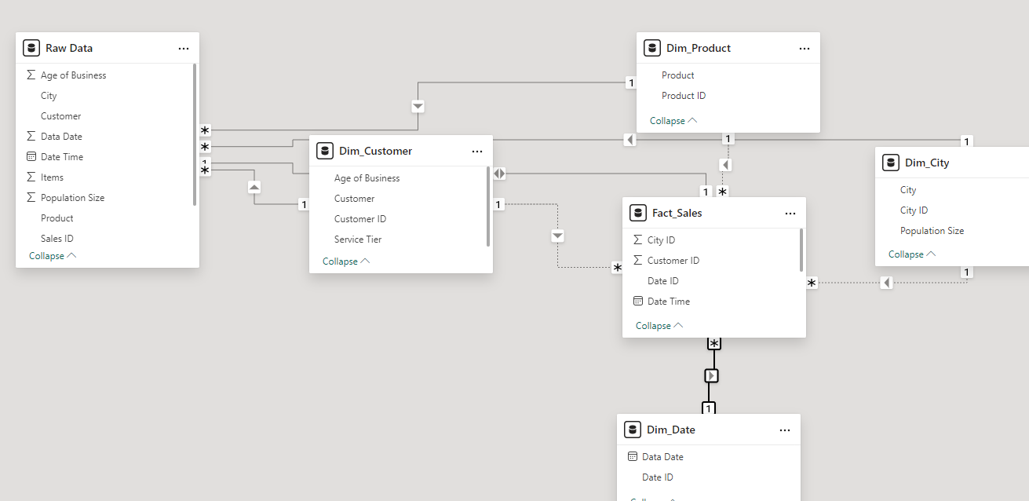
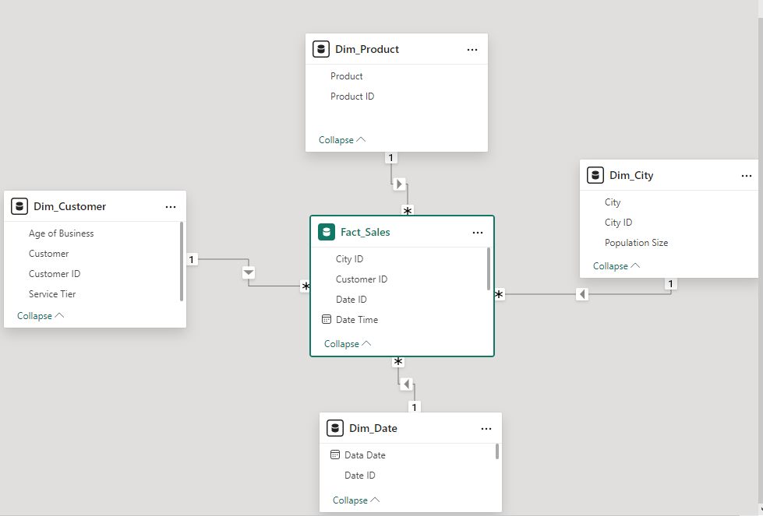
Disconnect Raw Data Relationships Recreate Relationships
Want this
Given this

Slide 26
Extend Date Dimension Table Insert Columns
Select >
Dim_Date
New Column >
Formatted Date = FORMAT(Dim_Date[Data Date],"YYYY-mm-dd")
New Column >
Year = YEAR(Dim_Date[Data Date])
New Column >
Month = INT(RIGHT(LEFT(Dim_Date[Formatted Date],7),2))
New Column >
Quarter = QUARTER(Dim_Date[Data Date])

Slide 27
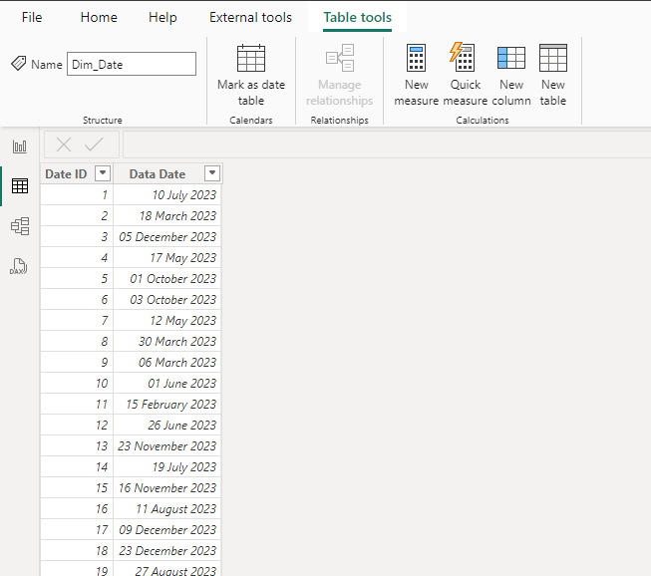
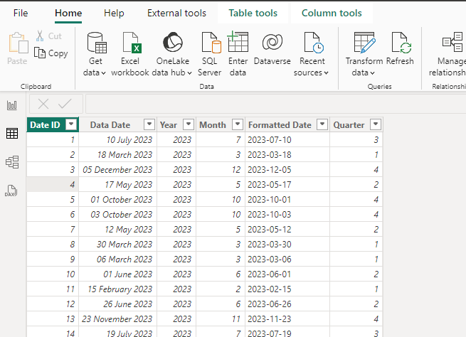
Extended Date Dimension Table

Slide 28
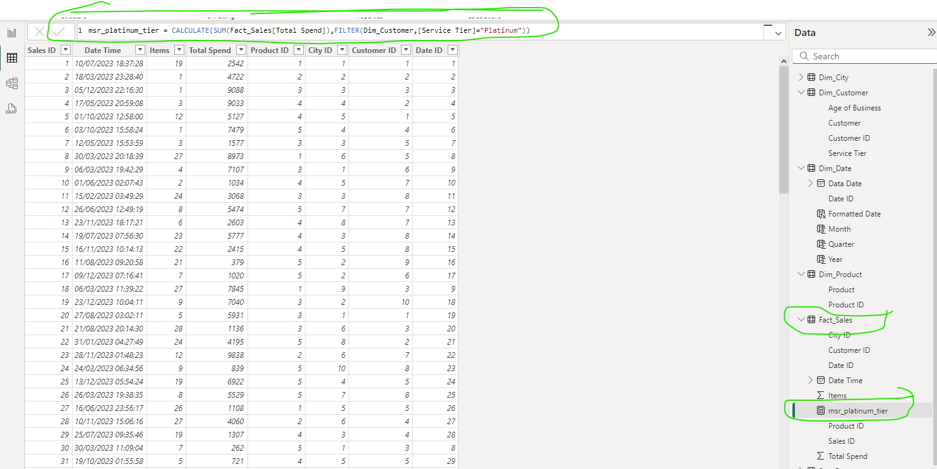
MEASURES
Data panel
Go to Fact table
New Measure
msr_platinum_tier = CALCULATE(SUM(Fact_Sales[Total Spend]),FILTER(Dim_Customer,[Service Tier]="Platinum"))
Pag1 1
Card

Slide 29
MEASURES
Data panel
Go to Fact table
New Measure
msr_customers_prod_items = CALCULATE(COUNT(Fact_Sales[Customer ID]),FILTER(Fact_Sales,(Fact_Sales[Product ID]=2 || Fact_Sales[Product ID] = 1) && Fact_Sales[Items]>25))
Pag1 1
Card > Fields > drag and drop the measure

Slide 30
Copilot – Prompt Aggregation using DAX
Please generate the dax code that will allow me to group by
Dim_Customer[Customer] and Dim_Product[Product] and then
calculate the sum of Fact_Sales[Total Spend] ,
WHERE Dim_City[Population Size] > 200000 and
sort by customer and product

Slide 31
Answer - Incorrect
EVALUATE
VAR FilteredSales =
FILTER(
ADDCOLUMNS(
Fact_Sales,
"Population Size", RELATED(Dim_City[Population Size])
),
[Population Size] > 200000
)
VAR GroupedSales =
SUMMARIZE(
FilteredSales,
Dim_Customer[Customer],
Dim_Product[Product],
"Total Spend", SUM(Fact_Sales[Total Spend])
)
RETURN
SORTBY(GroupedSales,Dim_Customer[Customer], ASC, Dim_Product[Product], ASC)

Slide 32
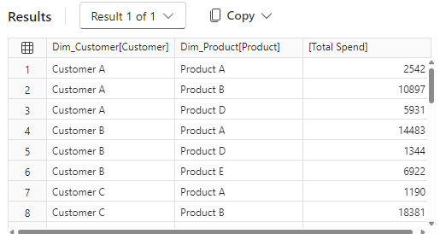
Answer – Correct
EVALUATE
VAR FilteredSales =
FILTER(
ADDCOLUMNS(
Fact_Sales,
"Population Size", RELATED(Dim_City[Population Size])
),
[Population Size] > 200000
)
VAR GroupedSales =
SUMMARIZE(
FilteredSales,
Dim_Customer[Customer],
Dim_Product[Product],
"Total Spend", SUM(Fact_Sales[Total Spend])
)
RETURN
GroupedSales ORDER BY Dim_Customer[Customer] ASC, Dim_Product[Product] ASC

Slide 33
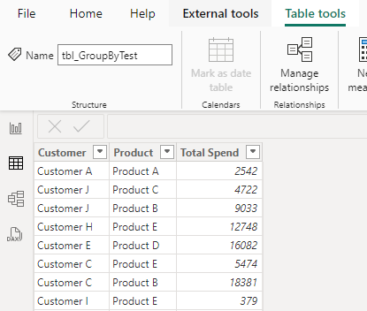
Creating a table from DAX Don’t include sorting
tbl_GroupByTest =
VAR FilteredSales =
FILTER(
ADDCOLUMNS(
Fact_Sales,
"Population Size", RELATED(Dim_City[Population Size])
),
[Population Size] > 200000
)
VAR GroupedSales =
SUMMARIZE(
FilteredSales,
Dim_Customer[Customer],
Dim_Product[Product],
"Total Spend", SUM(Fact_Sales[Total Spend])
)
RETURN
GroupedSales

Slide 34
Summary
Covered:
Data Modelling Concepts
Dimensional Modelling
Dimensional Modelling - Business Case
Designing a Data Model
Dimensional Model
Implementing a Data Model
Dimensional Model – Star Schema
Including Measures in the Data Model
Dax Aggregation within a Dimensional Model
Generating Reports

